Slide 1
Aurion: Health Information Exchange Technology Today
Alembic Foundation
OSCON 2011
July 27, 2011
David L. Riley, President, Alembic Foundation

Slide 2

Alembic Foundation: An Initiative for Better Health Data Sharing and Personal Data Management
Nonprofit organization (501(c)(3))
Transformation through disruptive
innovation using
  open processes in
  open communities to create
  open technologies that are contributed to the
  public commons.
Nurturing the Commons
  Open Source Custodian
  Open Source Community Start-up and management
  Open Source Testing and Certification
  Custodial Agent Operations

Slide 3
Alembic Foundation: An Initiative for Better Health Data Sharing and Personal Data Management
The Foundation aims to accomplish this in two ways:
  By serving as a neutral forum to foster collaboration with organizations and individuals from industry, the public and government to confront and solve real-world challenges
  By providing a basic toolset for communities of interest to organize themselves, define their project(s) and determine the relevant governance structure that assures success

Slide 4

What is Aurion?
Aurion is:
An Alembic Foundation Community
An Open Community-based Health Information Exchange (HIE) Software Project
An Open Source software implementation of NwHIN service specifications supporting the secure interoperable exchange of health information
An HIE Gateway
An Enterprise Solution
A CONNECT evolution

Slide 5

Aurion: An Alembic Foundation Community
Communities
  Self-organizing, self governing groups of like-minded individuals and organizations working to solve specific business challenges
Projects
  Focused initiatives undertaken by communities to produce technologies
Technologies
  Solutions developed in projects by communities
The Commons
  Open technologies released under licensing schemes to facilitate widespread adoption and use

Slide 6
Aurion: An Open Source Implementation of NwHIN Service Specifications
Aurion is released under the BSD Open Source Software
  Freely available for download
  Source code and binaries available for each release on the Aurion release webpage
  For Aurion 4.0 see Installation options: http://wiki.aurionproject.org/display/R40/Release+4.0+Home
Aurion implements the NwHIN Service Specifications
  Each Aurion release documents the NwHIN Specifications implemented in the release notes
  For Aurion 4.0 see: http://wiki.aurionproject.org/display/R40/NHIN+Specification+Reference

Slide 7
Aurion: An Open Community-based HIE Software Project
Aurion Community
  Chartered Alembic Foundation Community
  Open membership
  Board of Governors
  Meritocratic Software development community
  Community Website: http://aurionproject.org/
Aurion Software Development
  Volunteer developer community
    Currently 18 members from 5 different companies with commit privileges
  Agile software development lifecycle
    3 month release cycles
    2 week sprint cycles
  Developer Resources: http://development.aurionproject.org/sf/projects/aurion
Aurion Ecosystem
  Companies providing support and maintenances services available on the website

Slide 8
Aurion: An HIE Gateway Enterprise Solution
HIE Gateway
  Designed to sit at the “border” of an organization for business to business health information exchange
  Designed to participate in the NwHIN by installing NwHIN issued certificates and upon on-boarding services are discoverable by other NwHIN participants
  May be used for regional or local health information exchange
Enterprise Solution
  Designed to support small to large enterprises
  May be installed and managed locally
  May be implemented as a cloud solution

Slide 9
Aurion Genealogy: Aurion’s Link to CONNECT
Aurion is based on CONNECT
Aurion releases identical to CONNECT releases of the same number
  Aurion 2.4
  Aurion 3.0
  Aurion 3.1
Aurion 4.0 is an evolution of CONNECT
  Aurion 4.0 addressed outstanding CONNECT issue tracker items
  Added additional functionality
  For details see: http://wiki.aurionproject.org/display/R40/Release+Notes

Slide 10
Aurion Technical Approach
Aurion has 3 major architectural components
  Gateway
    Implements the NwHIN Service Specifications
  Adapter Framework
    SDK for integrating existing systems (EHRs Practice Management Systems, etc)
    Enterprise Service Components
  Universal Client Framework
    Framework for developing new applications that leverage the capabilities of the Enterprise Service Components

Slide 11
Aurion Implements NwHIN Exchange Specifications and Interoperates with the NwHIN Operational Infrastructure
Transaction Profiles
Utilize exchange patterns for specific transactions
CMS CARE
Doc Submission
CDC GIPSE
HIEM
MITA
Eligibility Verification
Discovery and Information Exchange Services
Rely on foundations to enable exchange patterns
Discovery
Pull
Push
Pub/Sub
Patient Discovery
Services Registry
Query & Retrieve Docs
Eligibility Verification
Doc Submission
HIEM
Messaging, Security, & Privacy Foundations
Enable private, secure, and interoperable communication of health information
Messaging Platform
Authorization Framework
Access Control Policy
Operational Infrastructure
Runtime systems that support the NHIN Limited Production Exchange
Security Infrastructure
(managed PKI)
Web Services Registry
Notes:
Patient Discovery – provides a means for a NHIN node to query another to determine if it is a source of information for a specific patient
Query & Retrieve Docs – an exchange pattern that allows NHIN nodes
to locate and retrieve patient-specific clinical documents held by other
NHIN nodes
Health Information Event Messaging (HIEM) – a publish/subscribe exchange pattern that allows a NHIN node to establish a subscription to information available from another for periodic exchange
Document Submission – a push mechanism that allows an initiating NHIN node to send one or more documents for a given patient to a receiving node
Services Registry Interface – provides a means for NHIN nodes to obtain information on other nodes and service endpoints
11

Slide 12
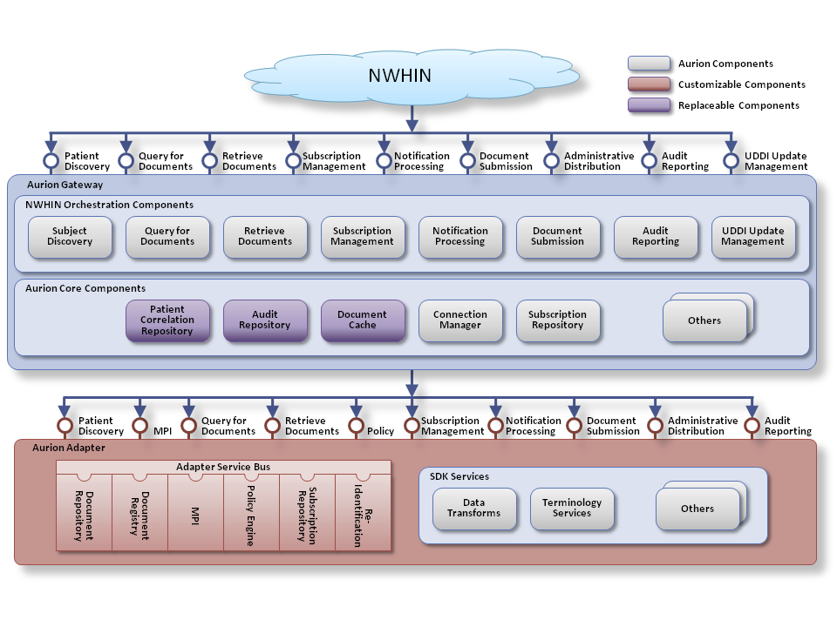
Aurion Architecture:
Message from NwHIN
Notes:
Need new 3.1 Image

Slide 13
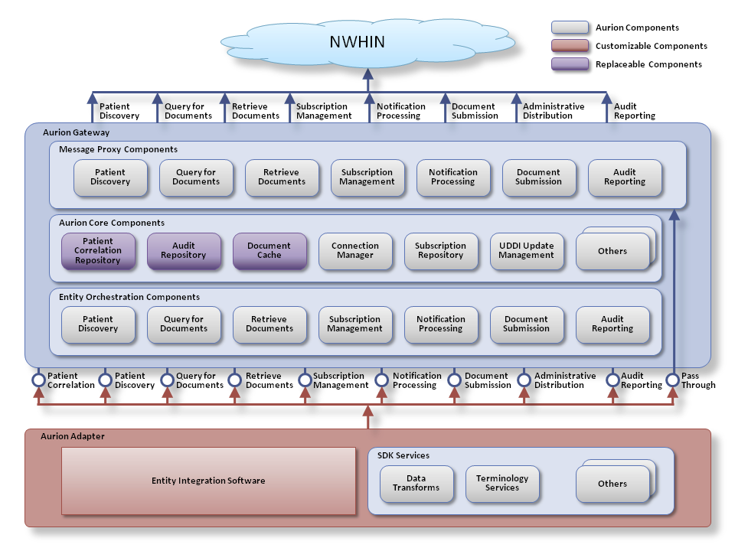
Aurion Architecture
Message to NwHIN
13
Notes:
Need new 3.1 Image

Slide 14
Aurion Development Environment
Version 4.0
Item | Version
Java JRE/JDK | 1.6 Update 25 (32-bit version)
GlassFish | 2.1.1
NetBeans | 6.7.1
Metro | 1.5
MySQL | 5.1.41
SoapUI | 3.5.1
NSS FIPS Library | 3.12.4
Notes:
Only change from 3.0: SoapUI 3.5.1

Slide 15
Aurion Technical Requirements
Download Software
  Choose Source Code or Binaries
  Pick OS: Windows, Solaris or Linux/JBOSS
  Download Third Party Components (eg Glassfish)
  Select Enterprise Service Component Plug-Ins as needed
  Aurion Validation Test Suites
Install Software in your environment
Install Certificates
Perform Validation Testing
For details on using Aurion to support HIE see: http://wiki.aurionproject.org/display/R40/Using+the+Aurion+Solution+to+Support+Health+Information+Exchange+(HIE)

Slide 16
Aurion Licensing and Support Model
Aurion is made freely available under the BSD License
  See: http://aurionproject.org/products/licensing
Aurion Support Model
  Support and Maintenance provided by Aurion Ecosystem
  See:
Budgetary Estimates
  Negotiate with Aurion Ecosystem Business Partners
  If specific functionality required on a specific timeline
    Negotiate priority with community
    Hire a contractor to develop
    Contract with Alembic Foundation to develop and deliver

Slide 17
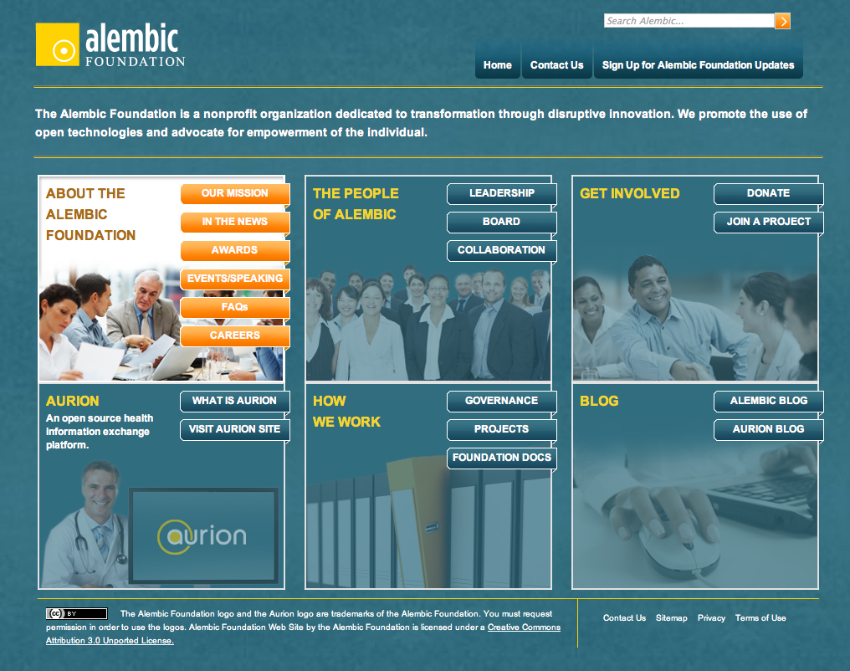

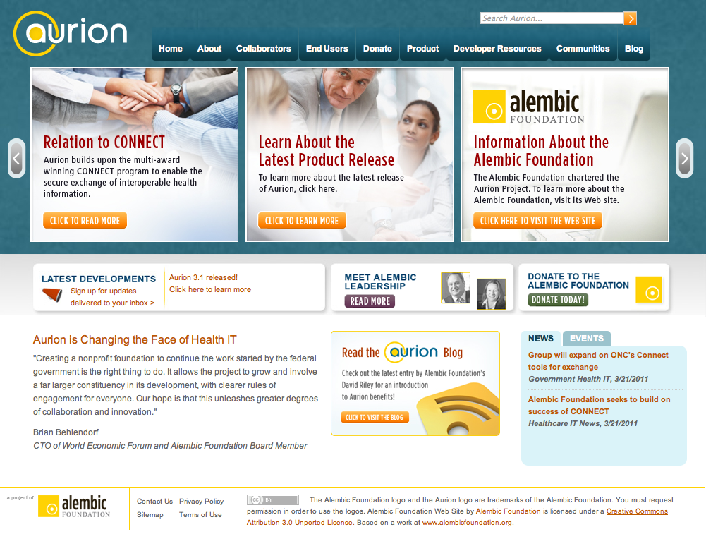

Contact Us
info@alembicfoundation.org
David Riley
President, Alembic Foundation
David.Riley@alembicfoundation.org
Vanessa Manchester
COO, Alembic Foundation
Vanessa.Manchester@alembicfoundation.org
www.alembicfoundation.org
www.aurionproject.org

